Slide 1
What are Modules, Packages, and Libraries?
By: Iman Khani Jazani
AI and Data Specialist, Business Developer | AiHum
Adjunct Professor | Sharif University of Technology
Senior Data Scientist, Community builder | Adin

Slide 2
Last Lecture
Short Presentations
Review the last lecture
Why do we need test? Is it necessary?!
How to implement in Python?
Application of Programming in the Digital Age!

Slide 3
Today
What is scope?
Module
Library
Package
Let’s do it with unit test!
حضور و غیاب
Application of Programming in the Digital Age

Slide 4
Together
Send your feedback about the class whenever you want!

Slide 5

Contact me
Gmail: ImanKhaniJazani@gmail.com
LinkedIn: https://www.linkedin.com/in/ImanKhaniJazani/
Telegram: @IKJ1992

Slide 6
Short Presentations

Slide 7
Review the Last Lecture

Slide 8
Different types of testing strategy
Manual
Automatic
Unit test
Integration test
Can you suggest other strategies?

Slide 9
What is scope?

Slide 10
Scope Level
Package
Library
Module
Class
Function
Body
S

Slide 11
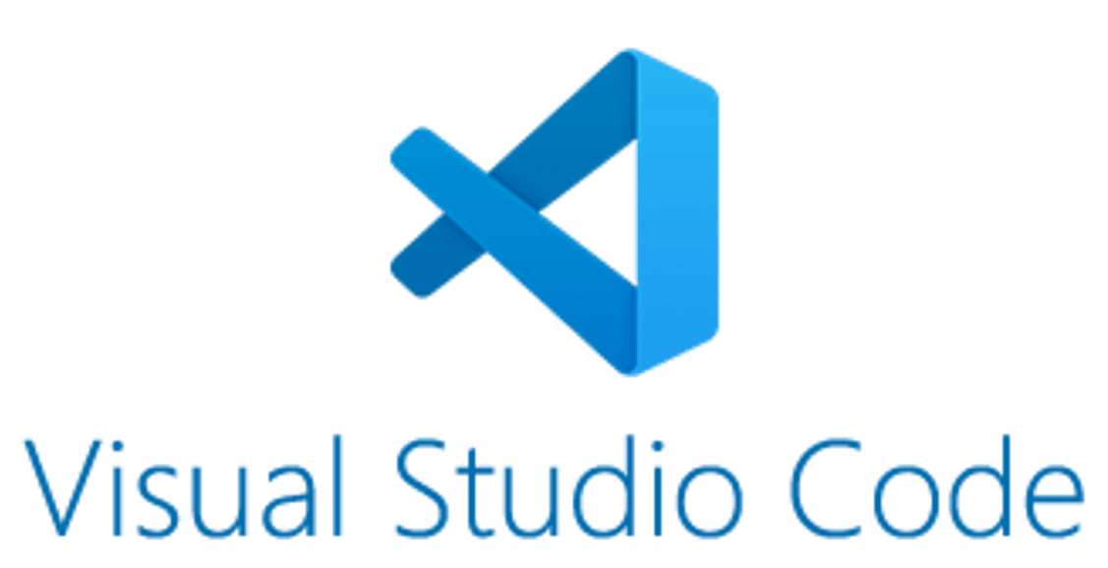

Simple structure, let’s do it!😉

Slide 12
Application of Programming in the Digital Age!

Slide 13

Amazon Kindle
Notes:
https://unity.com/

Slide 14
Lecture Resources
https://www.geeksforgeeks.org/what-is-the-difference-between-pythons-module-package-and-library/
https://realpython.com/lessons/scripts-modules-packages-and-libraries/

